Slide 1

Cloud Security
CIS 360 – Prof. C. R. Johnson
University of Wisconsin – Stevens Point

Slide 2
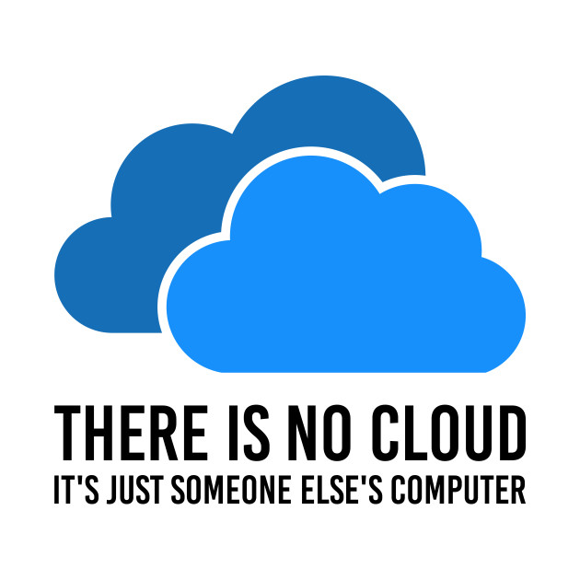
The National Institute of Standards and Technology (NIST) offers the following characteristics of the cloud.
On-demand self-service: The ability for an end user to sign up and receive services without the long delays that have characterized traditional IT.
Broad network access: The ability to access the service via standard platforms (desktop, laptop, mobile, etc.).
Resource pooling: Resources are pooled across multiple customers.
Rapid elasticity: Capability can scale to cope with demand peaks.
Measured service: Billing is metered and delivered as a utility service.

Slide 3
Cloud Computing
Features
Use of internet-based services to support business process
Rent IT-services on a utility-like basis
Attributes
Rapid deployment
Low startup costs/ capital investments
Costs based on usage or subscription
Multi-tenant sharing of services/ resources
“Cloud computing is a compilation of existing techniques and technologies, packaged within a new infrastructure paradigm that offers improved scalability, elasticity, business agility, faster startup time, reduced management costs, and just-in-time availability of resources”
Notes:
3
Government and Military sectors: complicated procurement rules and stringent security requirements
Cloud-based categories:
Cloud-based applications (SAAS)
Cloud-based development (e.g. Google App Engine)
Cloud-based infrastructure (e.g. Amazon’s EC2)

Slide 4
A Massive Concentration of Resources
Also a massive concentration of risk
expected loss from a single breach can be significantly larger
concentration of “users” represents a concentration of threats
“Ultimately, you can outsource responsibility but you can’t outsource accountability.”

Slide 5
Cloud Computing: who should use it?
Cloud computing definitely makes sense if your own security is weak, missing features, or below average.
Ultimately, if
the cloud provider’s security people are “better” than yours (and leveraged at least as efficiently),
the web-services interfaces don’t introduce too many new vulnerabilities, and
the cloud provider aims at least as high as you do, at security goals,
then cloud computing has better security.

Slide 6
Cloud Models
Delivery Models
SaaS
PaaS
IaaS
Deployment Models
Private cloud
Community cloud
Public cloud
Hybrid cloud
We propose one more Model: Management Models (trust and tenancy issues)
Self-managed
3rd party managed (e.g. public clouds and VPC)
Notes:
Trust and tenancy issues as well as loss of control related to the management model

Slide 7
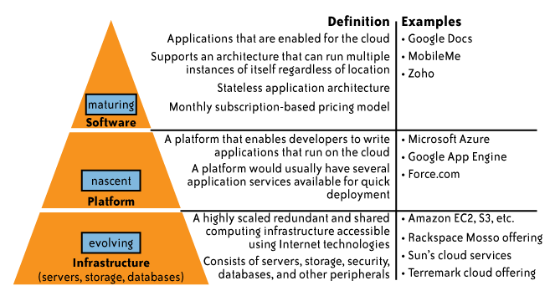
Delivery Models

Slide 8
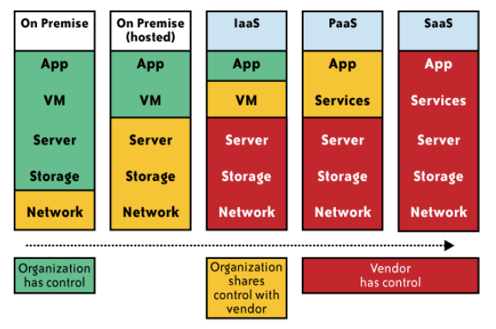
Impact of cloud computing on the governance structure of IT organizations

Slide 9
If cloud computing is so great, why isn’t everyone doing it?
The cloud acts as a big black box, nothing inside the cloud is visible to the clients
Clients have no idea or control over what happens inside a cloud
Even if the cloud provider is honest, it can have malicious system admins who can tamper with the VMs and violate confidentiality and integrity
Clouds are still subject to traditional data confidentiality, integrity, availability, and privacy issues, plus some additional attacks

Slide 10
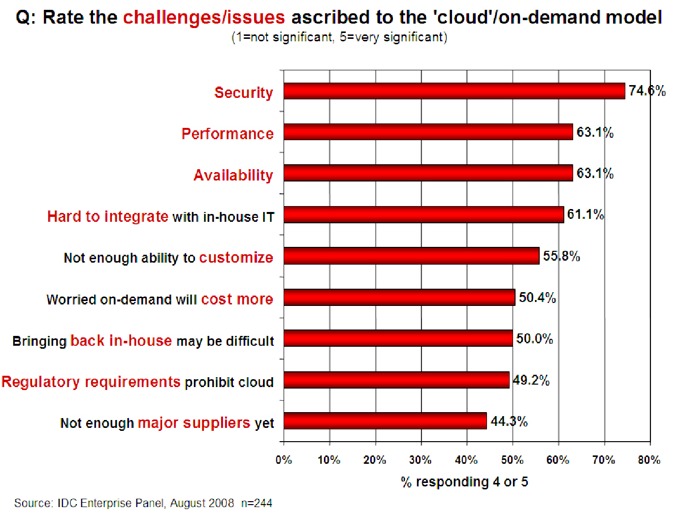

Slide 11
Causes of Problems Associated with Cloud Computing
Most security problems stem from:
Loss of control
Lack of trust (mechanisms)
Multi-tenancy
These problems exist mainly in 3rd party management models
Self-managed clouds still have security issues, but not related to above
Notes:
11
Data mobility: the ability to share data between cloud services
Where does data reside?
- out-of-state, out-of-country issues
Security Concerns for government in particular
FISMA
How to certify and accredit cloud computing providers under FISMA
(e.g. ISO 27001)

Slide 12
Loss of Control in the Cloud
Consumer’s loss of control
Data, applications, resources are located with provider
User identity management is handled by the cloud
User access control rules, security policies and enforcement are managed by the cloud provider
Consumer relies on provider to ensure
Data security and privacy
Resource availability
Monitoring and repairing of services/resources

Slide 13
Lack of Trust in the Cloud
Trusting a third party requires taking risks
Defining trust and risk
Opposite sides of the same coin (J. Camp)
People only trust when it pays (Economist’s view)
Need for trust arises only in risky situations
Defunct third party management schemes
Hard to balance trust and risk
e.g. Key Escrow (Clipper chip)
Is the cloud headed toward the same path?
Notes:
Chiles and McMakin (1996) define trust as increasing one’s vulnerability to the risk of opportunistic behavior of another whose behavior is not under one’s control in a situation in which the costs of violating the trust are greater than the benefits of upholding the trust.
Trust here means mostly lack of accountability and verifiability

Slide 14
Multi-tenancy Issues in the Cloud
Conflict between tenants’ opposing goals
Tenants share a pool of resources and have opposing goals
How does multi-tenancy deal with conflict of interest?
Can tenants get along together and ‘play nicely’ ?
If they can’t, can we isolate them?
How to provide separation between tenants?
Cloud Computing brings new threats
Multiple independent users share the same physical infrastructure
Thus an attacker can legitimately be in the same physical machine as the target
Notes:
Who are my neighbors? What is their objective? They present another facet of risk and trust requirements

Slide 15
Taxonomy of Fear
Confidentiality
Fear of loss of control over data
Will the sensitive data stored on a cloud remain confidential?
Will cloud compromises leak confidential client data
Will the cloud provider itself be honest and won’t peek into the data?
Integrity
How do I know that the cloud provider is doing the computations correctly?
How do I ensure that the cloud provider really stored my data without tampering with it?

Slide 16
Taxonomy of Fear (cont.)
Availability
Will critical systems go down at the client, if the provider is attacked in a Denial of Service attack?
What happens if cloud provider goes out of business?
Would cloud scale well-enough?
Often-voiced concern
Although cloud providers argue their downtime compares well with cloud user’s own data centers

Slide 17
Taxonomy of Fear (cont.)
Privacy issues raised via massive data mining
Cloud now stores data from a lot of clients, and can run data mining algorithms to get large amounts of information on clients
Increased attack surface
Entity outside the organization now stores and computes data, and so
Attackers can now target the communication link between cloud provider and client
Cloud provider employees can be phished

Slide 18
Taxonomy of Fear (cont.)
Auditability and forensics (out of control of data)
Difficult to audit data held outside organization in a cloud
Forensics also made difficult since now clients don’t maintain data locally
Legal quagmire and transitive trust issues
Who is responsible for complying with regulations?
e.g., SOX, HIPAA, GLBA ?
If cloud provider subcontracts to third party clouds, will the data still be secure?

Slide 19
Taxonomy of Fear (cont.)
Security is one of the most difficult task to implement in cloud computing.
Different forms of attacks in the application side and in the hardware components
Attacks with catastrophic effects only needs one security flaw

Slide 20
Threat Model
A threat model helps in analyzing a security problem, design mitigation strategies, and evaluate solutions
Steps:
Identify attackers, assets, threats and other components
Rank the threats
Choose mitigation strategies
Build solutions based on the strategies

Slide 21
Threat Model
Basic components
Attacker modeling
Choose what attacker to consider
insider vs. outsider?
single vs. collaborator?
Attacker motivation and capabilities
Attacker goals
Vulnerabilities / threats

Slide 22
What is the issue?
The core issue here is the levels of trust
Many cloud computing providers trust their customers
Each customer is physically commingling its data with data from anybody else using the cloud while logically and virtually you have your own space
The way that the cloud provider implements security is typically focused on they fact that those outside of their cloud are evil, and those inside are good.
But what if those inside are also evil?

Slide 23
Attacker Capability: Malicious Insiders
At client
Learn passwords/authentication information
Gain control of the VMs
At cloud provider
Log client communication
Can read unencrypted data
Can possibly peek into VMs, or make copies of VMs
Can monitor network communication, application patterns
Why?
Gain information about client data
Gain information on client behavior
Sell the information or use itself

Slide 24
Attacker Capability: Outside attacker
What?
Listen to network traffic (passive)
Insert malicious traffic (active)
Probe cloud structure (active)
Launch DoS
Goal?
Intrusion
Network analysis
Man in the middle
Cartography

Slide 25
Challenges for the attacker
How to find out where the target is located?
How to be co-located with the target in the same (physical) machine?
How to gather information about the target?

Slide 26
Part II: Security and Privacy Issues in Cloud Computing - Big Picture
Infrastructure Security
Data Security and Storage
Identity and Access Management (IAM)
Privacy
And more…

Slide 27
Infrastructure Security
Network Level
Host Level
Application Level

Slide 28
The Network Level
Ensuring confidentiality and integrity of your organization’s data-in-transit to and from your public cloud provider
Ensuring proper access control (authentication, authorization, and auditing) to whatever resources you are using at your public cloud provider
Ensuring availability of the Internet-facing resources in a public cloud that are being used by your organization, or have been assigned to your organization by your public cloud providers
Replacing the established model of network zones and tiers with domains

Slide 29
The Network Level - Mitigation
Note that network-level risks exist regardless of what aspects of “cloud computing” services are being used
The primary determination of risk level is therefore not which *aaS is being used,
But rather whether your organization intends to use or is using a public, private, or hybrid cloud.

Slide 30
The Host Level
SaaS/PaaS
Both the PaaS and SaaS platforms abstract and hide the host OS from end users
Host security responsibilities are transferred to the CSP (Cloud Service Provider)
You do not have to worry about protecting hosts
However, as a customer, you still own the risk of managing information hosted in the cloud services.

Slide 31
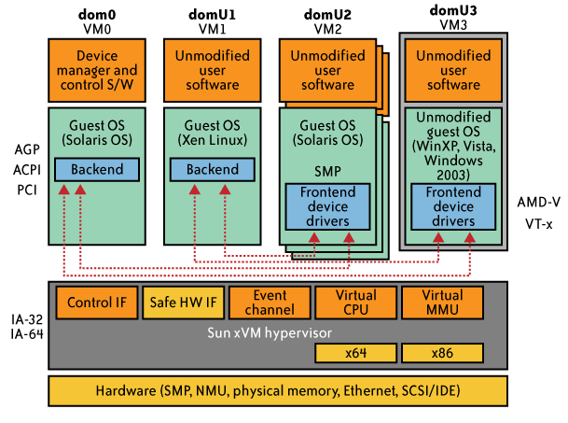
The Host Level (cont.)
IaaS Host Security
Virtualization Software Security
Hypervisor (also called Virtual Machine Manager (VMM)) security is a key
a small application that runs on top of the physical machine H/W layer
implements and manages the virtual CPU, virtual memory, event channels, and memory shared by the resident VMs
Also controls I/O and memory access to devices.
Bigger problem in multitenant architectures
Customer guest OS or Virtual Server Security
The virtual instance of an OS
Vulnerabilities have appeared in virtual instance of an OS
e.g., VMWare, Xen, and Microsoft’s Virtual PC and Virtual Server
Customers have full access to virtual servers.

Slide 32
Case study: Amazon's EC2 infrastructure
“Hey, You, Get Off of My Cloud: Exploring Information Leakage in Third-Party Compute Clouds”
Multiple VMs of different organizations with virtual boundaries separating each VM can run within one physical server
"virtual machines" still have internet protocol, or IP, addresses, visible to anyone within the cloud.
VMs located on the same physical server tend to have IP addresses that are close to each other and are assigned at the same time
An attacker can set up lots of his own virtual machines, look at their IP addresses, and figure out which one shares the same physical resources as an intended target
Once the malicious virtual machine is placed on the same server as its target, it is possible to carefully monitor how access to resources fluctuates and thereby potentially glean sensitive information about the victim

Slide 33
Local Host Security
Are local host machines part of the cloud infrastructure?
Outside the security perimeter
While cloud consumers worry about the security on the cloud provider’s site, they may easily forget to harden their own machines
The lack of security of local devices can
Provide a way for malicious services on the cloud to attack local networks through these terminal devices
Compromise the cloud and its resources for other users
Notes:
The lack of security of local devices can disrupt the consumer and also provide a way for malicious services on the cloud to attack local networks through these terminal devices. In today’s ubiquitous computing environment, the local host machine may well be a desktop computer, a portable laptop or mobile device. While cloud consumers worry about the security on the cloud provider’s site, they may easily forget to harden their own machines. The lack of security of a local host can compromise the cloud and its resources for other users. With mobile devices, the threat may be even stronger, as users misplace or have the device stolen from them. The security mechanisms on handheld gadgets are often times insufficient compared to say, a desktop computer, providing a potential attacker an easy avenue into a cloud system. If a user relies mainly on a mobile device to access cloud data, the threat to availability is also increased as mobile devices malfunction or are lost.
Devices that access the cloud should have strong authentication mechanisms, should be tamper-resistant, and have cryptographic functionality when traffic confidentiality is required. Since this places a part of the security burden onto the consumer, the provider may need to stipulate in its policy or SLA. New approaches to mobile cloud computing in which applications lie in the cloud as opposed to on a smart phone, enable more sophisticated security mechanisms.
Users connect to the cloud from their local host machines.
In particular, many secure cloud data storing technologies require users to generate master keys (used to encrypt data or session keys) and store them on the local machine. If a malicious service in the cloud can tamper with the local machine and access these keys, confidentiality of data stored in the cloud is at risk.
For example, a user’s computer can be a zombie that can be used to attack the cloud. Or it can contain malicious code that damages provider-side resources, affecting not only the provider, but all its other consumers as well.
In today’s battle space, new technologies enable war fighters to use handheld devices to gather data for analysis at command centers. Therefore, the durability and robustness of these devices is a major concern not only for cloud computing but for general-purpose military use as well.
Memory curtaining techniques for sensitive areas of memories such as those places where keys are stored (i.e. provides isolation of sensitive memory areas). Remote attestation or TPM type requirements.

Slide 34
Local Host Security (Cont.)
With mobile devices, the threat may be even stronger
Users misplace or have the device stolen from them
Security mechanisms on handheld gadgets are often times insufficient compared to say, a desktop computer
Provides a potential attacker an easy avenue into a cloud system.
If a user relies mainly on a mobile device to access cloud data, the threat to availability is also increased as mobile devices malfunction or are lost
Devices that access the cloud should have
Strong authentication mechanisms
Tamper-resistant mechanisms
Strong isolation between applications
Methods to trust the OS
Cryptographic functionality when traffic confidentiality is required

Slide 35
The Application Level
DoS
EDoS(Economic Denial of Sustainability)
An attack against the billing model that underlies the cost of providing a service with the goal of bankrupting the service itself.
End user security
Who is responsible for Web application security in the cloud?
SaaS/PaaS/IaaS application security
Customer-deployed application security

Slide 36
Data Security and Storage
Several aspects of data security, including:
Data-in-transit
Confidentiality + integrity using secured protocol
Confidentiality with non-secured protocol and encryption
Data-at-rest
Generally, not encrypted , since data is commingled with other users’ data
Encryption if it is not associated with applications?
But how about indexing and searching?
Then homomorphic encryption vs. predicate encryption?
Processing of data, including multitenancy
For any application to process data, not encrypted

Slide 37
Data Security and Storage (cont.)
Data lineage
Knowing when and where the data was located w/i cloud is important for audit/compliance purposes
e.g., Amazon AWS
Store <d1, t1, ex1.s3.amazonaws.com>
Process <d2, t2, ec2.compute2.amazonaws.com>
Restore <d3, t3, ex2.s3.amazonaws.com>
Data provenance
Computational accuracy (as well as data integrity)
E.g., financial calculation: sum ((((2*3)*4)/6) -2) = $2.00 ?
Correct : assuming US dollar
How about dollars of different countries?
Correct exchange rate?

Slide 38
Data Security and Storage
Data remanence
Inadvertent disclosure of sensitive information is possible
Data security mitigation?
Do not place any sensitive data in a public cloud
Encrypted data is placed into the cloud?
Provider data and its security: storage
To the extent that quantities of data from many companies are centralized, this collection can become an attractive target for criminals
Moreover, the physical security of the data center and the trustworthiness of system administrators take on new importance.

Slide 39
Why IAM?
Organization’s trust boundary will become dynamic and will move beyond the control and will extend into the service provider domain.
Managing access for diverse user populations (employees, contractors, partners, etc.)
Increased demand for authentication
personal, financial, medical data will now be hosted in the cloud
S/W applications hosted in the cloud requires access control
Need for higher-assurance authentication
authentication in the cloud may mean authentication outside F/W
Limits of password authentication
Need for authentication from mobile devices

Slide 40
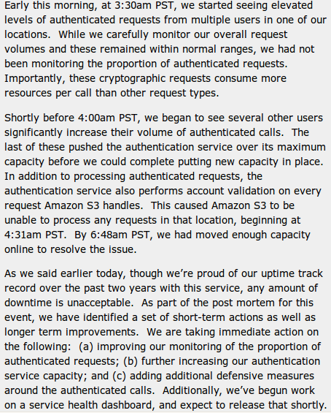
IAM considerations
The strength of authentication system should be reasonably balanced with the need to protect the privacy of the users of the system
The system should allow strong claims to be transmitted and verified w/o revealing more information than is necessary for any given transaction or connection within the service
Case Study: S3 outage
authentication service overload leading to unavailability
2 hours 2/15/08
http://www.centernetworks.com/amazon-s3-downtime-update

Slide 41
What is Privacy?
The concept of privacy varies widely among (and sometimes within) countries, cultures, and jurisdictions.
It is shaped by public expectations and legal interpretations; as such, a concise definition is elusive if not impossible.
Privacy rights or obligations are related to the collection, use, disclosure, storage, and destruction of personal data (or Personally Identifiable Information—PII).
At the end of the day, privacy is about the accountability of organizations to data subjects, as well as the transparency to an organization’s practice around personal information.

Slide 42
What Are the Key Privacy Concerns?
Typically mix security and privacy
Some considerations to be aware of:
Storage
Retention
Destruction
Auditing, monitoring and risk management
Privacy breaches
Who is responsible for protecting privacy?

Slide 43
Storage
Is it commingled with information from other organizations that use the same CSP?
The aggregation of data raises new privacy issues
Some governments may decide to search through data without necessarily notifying the data owner, depending on where the data resides
Whether the cloud provider itself has any right to see and access customer data?
Some services today track user behaviour for a range of purposes, from sending targeted advertising to improving services

Slide 44
Retention
How long is personal information (that is transferred to the cloud) retained?
Which retention policy governs the data?
Does the organization own the data, or the CSP?
Who enforces the retention policy in the cloud, and how are exceptions to this policy (such as litigation holds) managed?

Slide 45
Destruction
How does the cloud provider destroy PII at the end of the retention period?
How do organizations ensure that their PII is destroyed by the CSP at the right point and is not available to other cloud users?
Cloud storage providers usually replicate the data across multiple systems and sites—increased availability is one of the benefits they provide.
How do you know that the CSP didn’t retain additional copies?
Did the CSP really destroy the data, or just make it inaccessible to the organization?
Is the CSP keeping the information longer than necessary so that it can mine the data for its own use?

Slide 46
Auditing, monitoring and risk management
How can organizations monitor their CSP and provide assurance to relevant stakeholders that privacy requirements are met when their PII is in the cloud?
Are they regularly audited?
What happens in the event of an incident?
If business-critical processes are migrated to a cloud computing model, internal security processes need to evolve to allow multiple cloud providers to participate in those processes, as needed.
These include processes such as security monitoring, auditing, forensics, incident response, and business continuity

Slide 47
Privacy breaches
How do you know that a breach has occurred?
How do you ensure that the CSP notifies you when a breach occurs?
Who is responsible for managing the breach notification process (and costs associated with the process)?
If contracts include liability for breaches resulting from negligence of the CSP?
How is the contract enforced?
How is it determined who is at fault?

Slide 48
Who is responsible for protecting privacy?
e.g., Suppose a hacker breaks into Cloud Provider A and steals data from Company X.
Assume that the compromised server also contained data from Companies Y and Z.
Who investigates this crime?
Is it the Cloud Provider, even though Company X may fear that
the provider will try to absolve itself from responsibility?
Is it Company X and, if so, does it have the right to see other data on that server,
including logs that may show access to the data of Companies Y and Z?
Data breaches have a cascading effect
Full reliance on a third party to protect personal data?
In-depth understanding of responsible data stewardship
Organizations can transfer liability, but not accountability
Risk assessment and mitigation throughout the data life cycle is critical.
Many new risks and unknowns
The overall complexity of privacy protection in the cloud represents a bigger challenge.

Slide 49
Part III. Possible Solutions
Minimize Lack of Trust
Policy Language
Certification
Minimize Loss of Control
Monitoring
Utilizing different clouds
Access control management
Identity Management (IDM)
Minimize Multi-tenancy

Slide 50
Security Issues in the Cloud
In theory, minimizing any of the issues would help:
Third Party Cloud Computing
Loss of Control
Take back control
Data and apps may still need to be on the cloud
But can they be managed in some way by the consumer?
Lack of trust
Increase trust (mechanisms)
Technology
Policy, regulation
Contracts (incentives): topic of a future talk
Multi-tenancy
Private cloud
Takes away the reasons to use a cloud in the first place
VPC: its still not a separate system
Strong separation
Notes:
While VPC providers argue that they provide superior isolation, the fact of the matter is that your data is not a separate physical system: your data is still stored on actual servers along with other consumers’ data, but logically separated. If the actual server fails, your data and applications stored on it are lost. Also, there needs to be a high level of trust as to the degree of isolation provided.

Slide 51
Third Party Cloud Computing
Like Amazon’s EC2, Microsoft’s Azure
Allow users to instantiate Virtual Machines
Allow users to purchase required quantity when required
Allow service providers to maximize the utilization of sunk capital costs
Confidentiality is very important

Slide 52
Known issues: Already exist
Confidentiality issues
Malicious behavior by cloud provider
Known risks exist in any industry practicing outsourcing
Provider and its infrastructure needs to be trusted

Slide 53
New Vulnerabilities & Attacks
Threats arise from other consumers
Due to the subtleties of how physical resources can be transparently shared between VMs
Such attacks are based on placement and extraction
A customer VM and its adversary can be assigned to the same physical server
Adversary can penetrate the VM and violate customer confidentiality

Slide 54
More on attacks…
Collaborative attacks
Mapping of internal cloud infrastructure
Identifying likely residence of a target VM
Instantiating new VMs until one gets co-resident with the target
Cross-VM side-channel attacks
Extract information from target VM on the same machine

Slide 55
More on attacks…
Can one determine where in the cloud infrastructure an instance is located?
Can one easily determine if two instances are co-resident on the same physical machine?
Can an adversary launch instances that will be co-resident with other user instances?
Can an adversary exploit cross-VM information leakage once co-resident?
Answer: Yes to all

Slide 56
Minimize Lack of Trust: Policy Language
Consumers have specific security needs but don’t have a say-so in how they are handled
What the heck is the provider doing for me?
Currently consumers cannot dictate their requirements to the provider (SLAs are one-sided)
Standard language to convey one’s policies and expectations
Agreed upon and upheld by both parties
Standard language for representing SLAs
Can be used in a intra-cloud environment to realize overarching security posture
Notes:
These SLAs typically state the high level policies of the provider (e.g. Will maintain uptime of 98%) and do not allow cloud consumers to dictate their requirements to the provider. COI clouds in particular have specific security policy requirements that must be met by the provider, due to the nature of COIs and the missions they are used for. These requirements need to be communicated to the provider and the provider needs to provide some way of stating that the requirements can be met. Cloud consumers and providers need a standard way of representing their security requirements and capabilities. Consumers also need a way to verify that the provided infrastructure and its purported security mechanisms meet the requirements stated in the consumer’s policy (proof of assertions). For example, if the consumer’s policy requires isolation of VMs, the provider can create an assertion statement that says it uses cache separation to support VM isolation.

Slide 57
Minimize Lack of Trust: Policy Language (Cont.)
Create policy language with the following characteristics:
Machine-understandable (or at least processable),
Easy to combine/merge and compare
Examples of policy statements are, “requires isolation between VMs”, “requires geographical isolation between VMs”, “requires physical separation between other communities/tenants that are in the same industry,” etc.
Need a validation tool to check that the policy created in the standard language correctly reflects the policy creator’s intentions (i.e. that the policy language is semantically equivalent to the user’s intentions).

Slide 58
Minimize Lack of Trust: Certification
Certification
Some form of reputable, independent, comparable assessment and description of security features and assurance
Sarbanes-Oxley, DIACAP, DISTCAP, etc (are they sufficient for a cloud environment?)
Risk assessment
Performed by certified third parties
Provides consumers with additional assurance

Slide 59
Minimize Loss of Control: Monitoring
Cloud consumer needs situational awareness for critical applications
When underlying components fail, what is the effect of the failure to the mission logic
What recovery measures can be taken (by provider and consumer)
Requires an application-specific run-time monitoring and management tool for the consumer
The cloud consumer and cloud provider have different views of the system
Enable both the provider and tenants to monitor the components in the cloud that are under their control
Notes:
When the underlying components fail in the cloud, the effect of the failures to the mission logic needs to be known so that correct recovery measures can be performed. We propose an application-specific run-time monitoring and management tool. With this tool, the application logic can remain on the consumer’s host computer. This allows the consumer to centrally monitor all aspects of the application as well as data flow. Since all outputs from underlying services are sent to the application logic, any data incompatibility between services is not an issue. The capabilities of the run-time monitoring and management tool are as follows: 1) Enable application user to determine the status of the cloud resources that may be used to run the application (across multiple clouds), 2) Enable application user to determine the real-time security posture and situational awareness of the application, 3) Provide the application user with the ability to move user’s application (or part of it) to another site (other VM in same cloud or different cloud altogether), 4) Provide the application user with the ability to change the application logic on the fly, 5) Provide communicate capabilities with cloud providers. There are a few cloud vendors such as NimSoft [41] and Hyperic [42] that provide application-specific monitoring tools that provide some of the above functionality. These monitoring tools may be further enhanced or used in conjunction with other tools to provide the degree of monitoring required. However, any tool that is to be used for military purposes must also receive some type of accreditation and certification procedure.

Slide 60
Minimize Loss of Control: Monitoring (Cont.)
Provide mechanisms that enable the provider to act on attacks he can handle.
infrastructure remapping (create new or move existing fault domains)
shutting down offending components or targets (and assisting tenants with porting if necessary
Repairs
Provide mechanisms that enable the consumer to act on attacks that he can handle (application-level monitoring).
RAdAC (Risk-adaptable Access Control)
VM porting with remote attestation of target physical host
Provide ability to move the user’s application to another cloud

Slide 61
Minimize Loss of Control: Utilize Different Clouds
The concept of ‘Don’t put all your eggs in one basket’
Consumer may use services from different clouds through an intra-cloud or multi-cloud architecture
Propose a multi-cloud or intra-cloud architecture in which consumers
Spread the risk
Increase redundancy (per-task or per-application)
Increase chance of mission completion for critical applications
Possible issues to consider:
Policy incompatibility (combined, what is the overarching policy?)
Data dependency between clouds
Differing data semantics across clouds
Knowing when to utilize the redundancy feature (monitoring technology)
Is it worth it to spread your sensitive data across multiple clouds?
Redundancy could increase risk of exposure
Notes:
Differering data semantics example: does a data item labeled secret in one cloud have the same semantics as another piece of data also labeled secret in a different cloud?

Slide 62
Minimize Loss of Control: Access Control
Many possible layers of access control
E.g. access to the cloud, access to servers, access to services, access to databases (direct and queries via web services), access to VMs, and access to objects within a VM
Depending on the deployment model used, some of these will be controlled by the provider and others by the consumer
Regardless of deployment model, provider needs to manage the user authentication and access control procedures (to the cloud)
Federated Identity Management: access control management burden still lies with the provider
Requires user to place a large amount of trust on the provider in terms of security, management, and maintenance of access control policies. This can be burdensome when numerous users from different organizations with different access control policies, are involved
Notes:
In cloud computing (as well as other systems), there are many possible layers of access control. For example, access to the cloud, access to servers, access to services, access to databases (direct and queries via web services), access to VMs, and access to objects within a VM. Depending on the deployment model used, some of these will be controlled by the provider and others by the consumer.
For example, Google Apps, a representative SaaS Cloud controls authentication and access to its applications, but users themselves can control access to their documents through the provided interface to the access control mechanism. In IaaS type approaches, the user can create accounts on its virtual machines and create access control lists for these users for services located on the VM.
Regardless of the deployment model, the provider needs to manage the user authentication and access control procedures (to the cloud). While some providers allow federated authentication – enabling the consumer-side to manage its users, the access control management burden still lies with the provider. This requires the user to place a large amount of trust on the provider in terms of security, management, and maintenance of access control policies. This can be burdensome when numerous users from different organizations with different access control policies, are involved. This proposal focuses on access control to the cloud. However, the concepts here could be applied to access control at any level, if deemed necessary. We propose a way for the consumer to manage the access control decision-making process to retain some control, requiring less trust of the provider.
Approach:
This approach requires the client and provider to have a pre-existing trust relationship, as well as a pre-negotiated standard way of describing resources, users, and access decisions between the cloud provider and consumer. It also needs to be able to guarantee that the provider will uphold the consumer-side’s access decisions. Furthermore, we need to show that this approach is at least as secure as the traditional access control model.
This approach requires the data owner to be involved in all requests. Therefore, frequent access scenarios should not use this method if traffic is a concern. However, many secure data outsourcing schemes require the user to grant keys/certificates to the query side, so that every time the user queries a database, the owner needs to be involved. Therefore, not much different than that so may not be a problem.

Slide 63
Minimize Loss of Control: Access Control (Cont.)
Consumer-managed access control
Consumer retains decision-making process to retain some control, requiring less trust of the provider (i.e. PDP is in consumer’s domain)
Requires the client and provider to have a pre-existing trust relationship, as well as a pre-negotiated standard way of describing resources, users, and access decisions between the cloud provider and consumer. It also needs to be able to guarantee that the provider will uphold the consumer-side’s access decisions.
Should be at least as secure as the traditional access control model.
Facebook and Google Apps do this to some degree, but not enough control
Applicability to privacy of patient health records

Slide 64
Minimize Loss of Control: Access Control
Cloud Provider in Domain A
Cloud Consumer in Domain B
1. Authn request
IDP
PEP
(intercepts all
resource
access requests
from all client
domains)
3. Resource request (XACML Request) + SAML assertion
2. SAML Assertion
.
.
.
4. Redirect to domain of resource owner
PDP
for cloud
resource
on Domain A
5. Retrieve policy
for specified resource
resources
ACM
(XACML
policies)
7. Send signed and encrypted ticket
6. Determine whether user can access
specified resource
7. Create ticket for grant/deny
8. Decrypt and verify signature
9. Retrieve capability from ticket
10. Grant or deny access based on capability

Slide 65



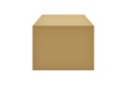

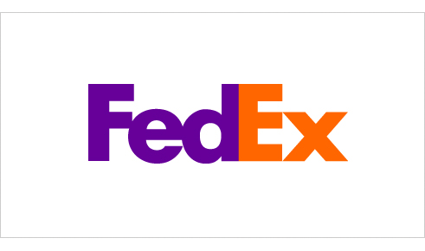
Minimize Loss of Control: IDM Motivation
User on Amazon Cloud
Name
E-mail
Password
Billing Address
Shipping Address
Credit Card
Name
Billing Address
Credit Card
Name
E-mail
Password
Billing Address
Shipping Address
Credit Card
Name
E-mail
Shipping Address
Name
E-mail
Shipping Address

Slide 66
Minimize Loss of Control: IDM Identity in the Cloud
User on Amazon Cloud
Name
E-mail
Password
Billing Address
Shipping Address
Credit Card
Name
Billing Address
Credit Card
Name
E-mail
Password
Billing Address
Shipping Address
Credit Card
Name
E-mail
Shipping Address
Name
E-mail
Shipping Address

Slide 67
Minimize Loss of Control: IDM Present IDMs
IDM in traditional application-centric IDM model
Each application keeps track of identifying information of its users.
Existing IDM Systems
Microsoft Windows CardSpace [W. A. Alrodhan]
OpenID [http://openid.net]
PRIME [S. F. Hubner]
These systems require a trusted third party and
do not work on an untrusted host.
If Trusted Third Party is compromised, all the identifying information of the users is also compromised

Slide 68
Minimize Loss of Control: IDM Issues in Cloud Computing
Cloud introduces several issues to IDM
Users have multiple accounts associated with multiple service providers.
Lack of trust
Use of Trusted Third Party is not an option
Cloud hosts are untrusted
Loss of control
Collusion between Cloud Services
Sharing sensitive identity information between services can lead to undesirable mapping of the identities to the user.
IDM in Cloud needs to be user-centric

Slide 69
Minimize Loss of Control: IDM Goals of Proposed User-Centric IDM for the Cloud
Authenticate without disclosing identifying information
Ability to securely use a service while on an untrusted host (VM on the cloud)
Minimal disclosure and minimized risk of disclosure during communication between user and service provider (Man in the Middle, Side Channel and Correlation Attacks)
Independence of Trusted Third Party

Slide 70
Minimize Loss of Control: IDM Approach - 1
IDM Wallet:
Use of AB scheme to protect PII from untrusted hosts.
Anonymous Identification:
Use of Zero-knowledge proofing for authentication of an entity without disclosing its identifier.

Slide 71
Minimize Loss of Control: IDM Components of Active Bundle (Approach – 1)
Identity data: Data used during authentication, getting service, using service (i.e. SSN, Date of Birth).
Disclosure policy: A set of rules for choosing Identity data from a set of identities in IDM Wallet.
Disclosure history: Used for logging and auditing purposes.
Negotiation policy: This is Anonymous Identification, based on the Zero Knowledge Proofing.
Virtual Machine: Code for protecting data on untrusted hosts. It enforces the disclosure policies.

Slide 72
Minimize Loss of Control: IDM Anonymous Identification (Approach – 1)
Anonymous Identification
(Shamir's approach for Credit Cards)
IdP provides Encrypted Identity Information to the user and SP.
SP and User interact
Both run IdP's public function on the certain bits of the Encrypted data.
Both exchange results and agree if it matches.

Slide 73
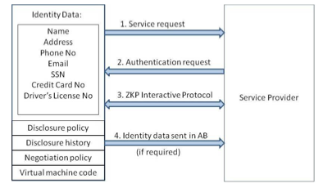
Minimize Loss of Control: IDM Usage Scenario (Approach – 1)

Slide 74
Minimize Loss of Control: IDM Approach - 2
Active Bundle scheme to protect PII from untrusted hosts
Predicates over encrypted data to authenticate without disclosing unencrypted identity data.
Multi-party computing to be independent of a trusted third party

Slide 75
Minimize Loss of Control: IDM Usage Scenario (Approach – 2)
Owner O encrypts Identity Data(PII) using algorithm Encrypt and O’s public key PK. Encrypt outputs CT—the encrypted PII.
SP transforms his request for PII to a predicate represented by function p.
SP sends shares of p to the n parties who hold the shares of MSK.
n parties execute together KeyGen using PK, MSK, and p, and return TKp to SP.
SP calls the algorithm Query that takes as input PK, CT, TKp and produces p(PII) which is the evaluation of the predicate.
The owner O is allowed to use the service only when the predicate evaluates to “true”.

Slide 76
Minimize Loss of Control: IDM Representation of identity information for negotiation
Token/Pseudonym
Identity Information in clear plain text
Active Bundle

Slide 77
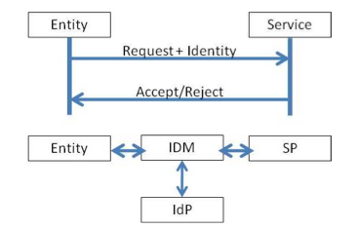
Minimize Loss of Control: IDM Motivation-Authentication Process using PII
Problem: Which information to disclose and how to disclose it.

Slide 78
Proposed IDM: Active Bundle
Active bundle (AB)
An encapsulating mechanism protecting data carried within it
Includes data
Includes metadata used for managing confidentiality
Both privacy of data and privacy of the whole AB
Includes Virtual Machine (VM)
performing a set of operations
protecting its confidentiality

Slide 79
Proposed IDM: Active Bundle (Cont.)
Active Bundles—Operations
Self-Integrity check
E.g., Uses a hash function
Evaporation/ Filtering
Self-destroys (a part of) AB’s sensitive data when threatened with a disclosure
Apoptosis
Self-destructs AB’s completely

Slide 80
Proposed IDM: Characteristics and Advantages
Ability to use Identity data on untrusted hosts
Self Integrity Check
Integrity compromised- apoptosis or evaporation
Data should not be on this host
Independent of Third Party
Prevents correlation attacks
Establishes the trust of users in IDM
Through putting the user in control of who has his data
Identity is being used in the process of authentication, negotiation, and data exchange.
Minimal disclosure to the SP
SP receives only necessary information.

Slide 81
Proposed IDM: Conclusion & Future Work
Problems with IDM in Cloud Computing
Collusion of Identity Information
Prohibited Untrusted Hosts
Usage of Trusted Third Party
Proposed Approaches
IDM based on Anonymous Identification
IDM based on Predicate over Encrypted data
Future work
Develop the prototype, conduct experiments and evaluate the approach

Slide 82
Minimize Multi-tenancy
Can’t really force the provider to accept less tenants
Can try to increase isolation between tenants
Strong isolation techniques (VPC to some degree)
C.f. VM Side channel attacks (T. Ristenpart et al.)
QoS requirements need to be met
Policy specification
Can try to increase trust in the tenants
Who’s the insider, where’s the security boundary? Who can I trust?
Use SLAs to enforce trusted behavior

Slide 83
Conclusion
Cloud computing is sometimes viewed as a reincarnation of the classic mainframe client-server model
However, resources are ubiquitous, scalable, highly virtualized
Contains all the traditional threats, as well as new ones
In developing solutions to cloud computing security issues it may be helpful to identify the problems and approaches in terms of
Loss of control
Lack of trust
Multi-tenancy problems

